Slide 1
CECS 326 Operating Systems
Process Synchronization
(Chapter 5, Operating system Concepts by Silberschatz, Galvin and Gagne)

Slide 2
Background
Processes can execute concurrently
Process executes instructions one after another, but may be interrupted at any time between instruction execution
Concurrent access to shared data may lead to race condition, resulting in data inconsistency
Maintaining data consistency requires mechanisms to ensure orderly execution of cooperating processes
Illustration of the problem:
Previous solution to the producer-consumer problem leaves one slot unused to enable distinction between the conditions of full vs. empty buffer. This deficiency may be overcome by using an integer counter that keeps track of the number of filled buffer slots. The counter is set to 0 initially, incremented by the producer after each data it places in the buffer and decremented by the consumer after it removes a data from it.

Slide 3
Producer-Consumer Problem
Producer
Consumer
while (true) { /* produce an item in next_produced */
while (counter==BUFFER_SIZE);
/* do nothing */
buffer[in]=next_produced;
in=(in+1)%BUFFER_SIZE;
counter++;
}
while (true) {
while (counter==0);
/* do nothing */
next_consumed=buffer[out];
out = (out+1)% BUFFER_SIZE;
counter--;
/* consume the item in next_consumed */
}

Slide 4
Race Condition
counter++ could be implemented as
(INC1) register1 = counter
(INC2) register1 = register1 + 1
(INC3) counter = register1
counter–- could be implemented as
(DEC1) register2 = counter
(DEC2) register2 = register2 - 1
(DEC3) counter = register2
Consider the following execution interleaving with counter = 5 initially:
Producer execute INC1 (counter = 5, register1 = 5)
Producer execute INC2 (counter = 5, register1 = 6)
Consumer execute DEC1 (counter = 5, register2 = 5)
Consumer execute DEC2 (counter = 5, register2 = 4)
Producer execute INC3 (counter = 6, register1 = 6)
Consumer execute DEC3 (counter = 4, register2 = 4)
Value of counter is erroneous (correct value is 5)

Slide 5
Critical Section (CS)
Cause of inconsistency in shared data counter is that it is manipulated concurrently by two processes
Process requires mutually exclusive access to shared data to ensure integrity
Section of code where such exclusive access is required is called Critical Section
Critical sections in the producer-consumer implementation:
All statements where counter is referenced
Critical section problem is to design protocol to ensure that when one process is in its critical section, no other may be in its critical section

Slide 6
Requirements of Solution to Critical-Section Problem
Mutual Exclusion – If process P_{i} is executing in its critical section, then no other process can be executing in their critical sections
Progress – If no process is executing in its critical section and there exist some processes that wish to enter their critical section, then the selection of the processes that will enter the critical section next cannot be postponed indefinitely
Bounded Waiting – A bound must exist on the number of times that other processes are allowed to enter their critical sections after a process has made a request to enter its critical section and before that request is granted
Assume that each process executes at a nonzero speed
No assumption concerning relative speed of the n processes

Slide 7
Simple Algorithm (1) for Two Processes
Given processes P₀ and P₁
Use a shared variable “turn” to control which process can enter critical section
Initialize turn to 0
P₀ : P₁:
while (turn != 0) while (turn != 1)
/* do nothing */ ; /* do nothing */ ;
<critical section> <critical section>
turn = 1; turn = 0;
Problem with solution?

Slide 8
Simple Algorithm (2) for Two Processes
Given processes P₀ and P₁
Use shared Boolean array “flag” to control which process can enter critical section
Initialize both flag[0] and flag[1] to false
P₀ : P₁:
flag[0] = true; flag[1] = true;
while (flag[1]){ while (flag[0]){
flag[0] = false; flag[1] := false;
/* delay */ /* delay */
flag[0] = true; flag[1] := true;
} }
<critical section> <critical section>
flag[0] = false; flag[1] := false;
Problem with solution?

Slide 9
Peterson’s Algorithm for Two Processes
Given processes P₀ and P₁
Use two shared variables
int turn /* indicates whose turn it is to enter CS */
Boolean flag[2] /* flag[i] = true indicates that process is ready to enter CS */
P_{i}:
do {
flag[i] = true;
turn = j;
while (flag[j] && turn == j) /* do nothing */ ;
<critical section>
flag[i] = false;
<remainder section>
} while (true);
Provable that the three CS requirements are met:
Mutual exclusion is preserved (P_{i} enters CS only if either flag[j]= false or turn=i)
Progress requirement is satisfied
Bounded waiting requirement is met

Slide 10
Critical Section Handling in OS
At any given time, many kernel-mode processes may be active in the OS
These processes may need to manipulate shared data structures (e.g., ready queue, wait queues for various resources, file descriptors) and hence are subject to possible race conditions
Two approaches are used to handle critical sections in OS:
Preemptive kernel – allows preemption of process when running in kernel mode
Non-preemptive kernel – a kernel-mode process runs until it exits kernel mode, blocks, or voluntarily yields CPU (essentially free of race conditions)

Slide 11
Synchronization Hardware
Many systems provide hardware support for implementing the critical section code
Could disable interrupts
Currently running code would execute without preemption
Won’t work unless on a uniprocessor system, or all CPUs are disabled of interrupts at the same time. Too inefficient.
Modern machines provide special atomic hardware instructions that can be used to implement a “locking” mechanism
Atomic means non-interruptible
A “test_and_set” instruction to test memory word and set value
A “swap” instruction to swap contents of two memory words

Slide 12
A Simple Idea For N Processes
Given processes P₀, P₁,and P_{n-1}
Use a Boolean shared variable flag to indicate status of shared resource
flag = true mean shared resource is available, OK to enter CS
flag = false means shared resource is in use, DO NOT enter CS
flag is initialized to true
P_{i}:
do {
while (!flag); /* keep testing, stay out until true */
flag = false; /* set flag to block out other processes */
<critical section>
flag = true; /* reset flag */
<remainder section>
} while (true);
Solution does not enforce mutual exclusion. Two or more processes may find flag = true, exit while loop, set flag to false, and enter CS

Slide 13
A Simple Idea For N Processes (cont.)
Problem with this solution
Operations for testing value of flag and setting it to a specific value can be interrupted
For this idea to work, these operations must be atomic (indivisible)
A “test_and_set” instruction is designed to meet this need
Definition:
Boolean test_and_set (Boolean *target){
Boolean rv = *target;
*target = TRUE;
return rv:
}
Executed atomically
Returns the original value of passed parameter
Set new value of passed parameter to true

Slide 14
Solution Using test_and_set()
Shared Boolean variable lock, initialized to FALSE
Solution
do { while (test_and_set(&lock)); /* condition not
right, stay out, keep checking */
< critical section >
lock = false;
< remainder section >
} while (true);

Slide 15
Bounded-waiting Mutual Exclusion with test_and_set()
Given processes P₀, P₁,and P_{n-1} ; lock is a shared variable initialized to false
Code for P_{i}:
do { waiting[i] = true; key = true; while (waiting[i] && key)
key = test_and_set(&lock);
waiting[i] = false;
< critical section >
j = (i + 1) % n;
while ((j != i) && !waiting[j]) /* find next waiting
j = (j + 1) % n; /* process & pass lock to it */
if (j == i)
lock = false;
else
waiting[j] = false;
< remainder section >
} while (true);

Slide 16
Mutex Lock
Previous solution is complicated and generally inaccessible to application programmers
OS designers build software tools to solve CS problem
The simplest is mutex lock
CS is protected using acquire() and release(), which are defined based on a Boolean variable that indicates if lock is available or not
Calls to acquire() and release() must be atomic, usually implemented via hardware atomic instructions
This solution requires busy waiting. This lock is therefore called a spinlock.

Slide 17
acquire() and release()
acquire() { while (!available)
; /* busy wait */
available = false;;
}
release() {
available = true;
}
do {
acquire lock
< critical section >
release lock
< remainder section >
} while (true);

Slide 18
Semaphore
Synchronization tool that provides more sophisticated ways than mutex locks for processes to synchronize their activities
Semaphore S
Can only be accessed via two indivisible (atomic) operations wait() and signal() (originally called P() and V() )
Definition involving busy waiting – S, an integer variable
wait(S) {
while (S <= 0)
; // busy wait
S--;
}
signal(S) {
S++;
}

Slide 19
Semaphore Usage
Can solve various synchronization problems
For example, consider processes P₁ and P₂ that require S₁ to happen before S₂ :
Create a semaphore “synch” initialized to 0
P1:
S₁;
signal(synch);
P2:
wait(synch);
S₂;

Slide 20
Semaphore Implementation
Must guarantee that no two processes can execute wait() and signal() on the same semaphore at the same time
Thus, implementation of these operations becomes a critical section problem where the wait and signal code are critical sections
When a process is executing a long CS, other processes block themselves out of their CS in busy waiting occupying CPU non-productively. It is therefore desirable to have an implementation with no busy waiting.

Slide 21
Semaphore Implementation with No Busy Waiting
Each semaphore consists of an integer and a queue, defined as
typedef struct{
int value;
struct process *list;
} semaphore;
To eliminate busy waiting, the following two operations are needed:
Block – place the process invoking the operation on an appropriate waiting queue
Wakeup – remove one of the processes in the waiting queue and place it in the ready queue

Slide 22
Semaphore Implementation with No Busy Waiting
wait(semaphore *S) {
S->value--;
if (S->value < 0) { add this process to S->list;
block();
}
}
signal(semaphore *S) {
S->value++;
if (S->value <= 0) { remove a process P from S->list;
wakeup(P);
}
}

Slide 23
Classical Problems of Synchronization
Problems that have different synchronization requirements:
Bounded-buffer problem
Readers and writers problem
Dining philosophers problem

Slide 24
Bounded-Buffer Problem
A buffer with n slots, each can hold one data item
Semaphore solution:
Semaphore mutex initialized to 1
Semaphore full initialized to 0
Semaphore empty initialized to n

Slide 25
Bounded-Buffer Problem - Semaphore Solution
Producer process
do {
... /* produce an item in next_produced */
...
wait(empty);
wait(mutex);
... /* add next_produced to the buffer */
...
signal(mutex);
signal(full);
} while (true);
Consumer process
do {
wait(full);
wait(mutex);
... /* remove an item from buffer to next_consumed */
...
signal(mutex);
signal(empty);
... /* consume the item in next_consumed */
... } while (true);

Slide 26
End of midterm coverage

Slide 27
Readers-Writers Problem
A data set is shared among a number of concurrent processes
Readers – only read the data set, they do not perform any updates
Writers – can both read and write
Issues to address
Allow multiple readers to read at the same time
Only one single writer can access at a time
Several variations of how readers and writers are considered in providing their access, all involve some form of priorities
Shared data
Data set
Semaphore rw_mutex initialized to 1
Semaphore mutex initialized to 1
Integer read_count initialized to 0

Slide 28
Readers-Writers Problem
Reader
do { wait(mutex); read_count++; if (read_count == 1)
wait(rw_mutex);
signal(mutex);
... /* reading is performed */
...
wait(mutex); read count--; if (read_count == 0)
signal(rw_mutex);
signal(mutex);
} while (true);
Writer
do { wait(rw_mutex);
... /* writing is performed */
...
signal(rw_mutex);
} while (true);

Slide 29

Dining-Philosophers Problem
Philosophers spend their lives alternating thinking and eating
No interaction with neighbors. Occasionally try to pick up 2 chopsticks (one at a time) to eat from bowl. Need both to eat, then release both when done
Shared data, for the case with 5 philosophers
Bowl of rice (data set)
Semaphore chopsticks[5], all initialized to 1

Slide 30
Dining-Philosophers Problem
Philosopher i
do {
// think
wait (chopstick[i] );
wait (chopStick[ (i + 1) % 5] );
// eat
signal (chopstick[i] );
signal (chopstick[ (i + 1) % 5] );
} while (TRUE);
Problem with this solution?

Slide 31
Dining-Philosophers Problem
Deadlock handling
Allow at most 4 philosophers to be sitting simultaneously at the table
Allow a philosopher to pick up the chopsticks only if both are available (i.e., picking must be done in a critical section)
Use an asymmetric solution – an odd-numbered philosopher picks up first the left chopstick and then the right chopstick, and even-numbered philosopher picks up first the right chopstick and then the left chopstick

Slide 32
Problems with Semaphores
Incorrect use of semaphore operations
signal(mutex) … wait (mutex)
wait(mutex) … wait (mutex)
Omitting of wait (mutex) or signal (mutex) or both
Deadlock and starvation are possible

Slide 33
Monitors
A high-level abstraction that provides a convenient and effective mechanism for process synchronization
Abstract data type, internal variables only accessible by code in procedures within it
Only one process may be active within the monitor at a time
But not powerful enough to model all synchronization schemes
Structure or a monitor
Monitor monitor-name
{
// shared variable declarations
procedure P1 ( … ) { … }
procedure P2 ( … ) { … }
Initialization code
}

Slide 34
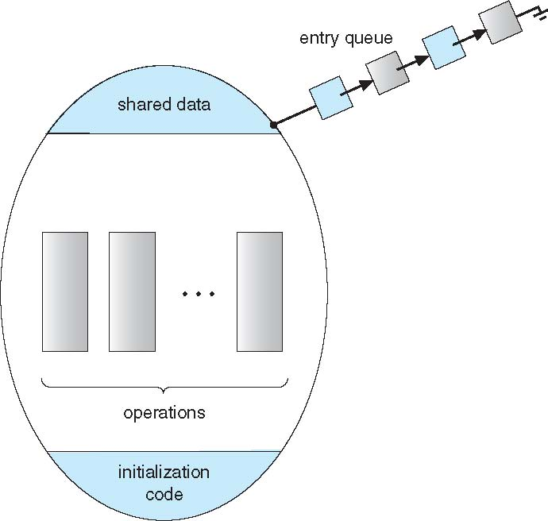
Schematic View of a Monitor

Slide 35
Condition Variables
Declaration
condition x, y;
Two operations are available on a condition variable x:
x.wait() – a process that invokes this operation is suspended until x.signal()
x.signal() – resumes one of the processes (if any) that invoked x.wait(). No effect iIf no x.wait() on the variable x.

Slide 36
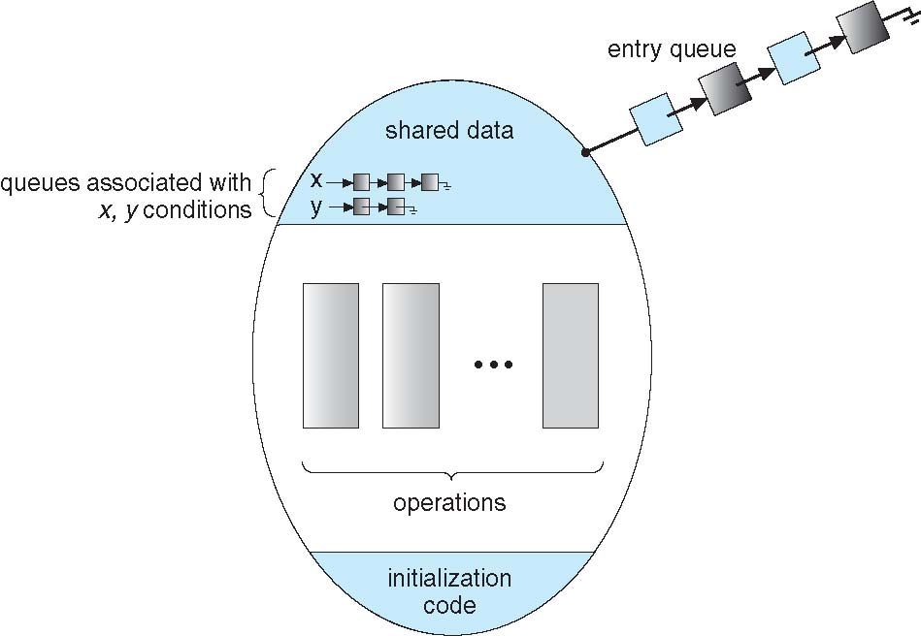
Schematic View of Monitor with Condition Variables

Slide 37
Choice of Implementation of Condition Variables
If process P invokes x.signal(), and process Q is suspended in x.wait(), what should happen next?
Issue: both P and Q cannot execute concurrently. If Q resumed then P must wait
Options include
Signal and wait – P waits until Q either leaves the monitor or it waits for another condition
Signal and continue – Q waits until P either leaves the monitor or it waits for another condition.
Both have pros and cons – language implementer can decide
Monitors implemented in Concurrent Pascal compromise
P executing signal immediately leaves the monitor, Q is resumed
Implemented in other languages including Mesa, C#, Java

Slide 38
Monitor Solution to Dining Philosophers
monitor DiningPhilosophers
{
enum { THINKING; HUNGRY, EATING) state [5] ;
condition self [5];
void pickup (int i) {
state[i] = HUNGRY;
test(i);
if (state[i] != EATING) self[i].wait;
}
void putdown (int i) {
state[i] = THINKING;
// test left and right neighbors, enable them to eat
// if hungry and waiting
test((i + 4) % 5);
test((i + 1) % 5);
}

Slide 39
Solution to Dining Philosophers (cont.)
void test (int i) {
if ((state[(i + 4) % 5] != EATING) &&
(state[(i + 1) % 5] != EATING) &&
(state[i] == HUNGRY)) {
state[i] = EATING ;
self[i].signal() ;
}
}
initialization_code() {
for (int i = 0; i < 5; i++)
state[i] = THINKING;
}
}

Slide 40
Solution to Dining Philosophers (cont.)
Each philosopher i invokes the operations pickup() and putdown() in the following sequence:
DiningPhilosophers.pickup(i);
EAT
DiningPhilosophers.putdown(i);
No deadlock, but starvation is possible

Slide 41
Monitor Solution to Producer/Consumer Problem
monitor bounded-buffer
{
message B[N]; // message: a user-defined type
// N a predefined constant
int in, out, count;
condition nonfull, nonempty;
void place( message x) {
if (count == N) nonfull.wait;
B[in] = x;
in = (in + 1) % N;
count = count + 1;
nonempty.signal;
}

Slide 42
Solution to Producer/Consumer (cont)
void remove( message* x ) {
if (count == 0) nonempty.wait;
x = B[out];
out = (out + 1) % N;
count = count - 1;
nonfull.signal;
}
initialization_code() {
in = 0;
out = 0;
count = 0;
}
}

Slide 43
Solution to Producer/Consumer (cont)
Each producer invokes place() operation as follows:
. . .
produce message m;
bounded-buffer.place (m);
. . .
Each consumer invokes remove() operation as follows:
. . .
bounded-buffer.remove(m);
consume message m;
. . .

Slide 44
Resuming Processes within a Monitor
If several processes queued on condition x, and x.signal() is executed, which should be resumed?
FCFS frequently not adequate
Conditional-wait construct of the form x.wait(c)
Where c is priority number
Processes with lowest number (highest priority) is scheduled next

Slide 45
Single Resource Allocation Problem
Allocate a single resource among competing processes using priority numbers that specify the maximum time a process plans to use the resource
R.acquire(t);
. . .
Access the resource
. . .
R.release;
where R is an instance of type ResourceAllocator

Slide 46
A Monitor to Allocate Single Resource
monitor ResourceAllocator
{
boolean busy;
condition x;
void acquire(int time) {
if (busy)
x.wait(time); // processes queue in shortest
// job first order
busy = TRUE;
}
void release() {
busy = FALSE;
x.signal();
}
initialization code() {
busy = FALSE;
}
}

Slide 47
Synchronization Example - Linux
Prior to kernel Version 2.6, disables interrupts to implement short critical sections. Version 2.6 and later, fully preemptive
Linux provides:
Atomic integers
Mutex locks
Semaphores
Spinlocks
Reader-writer versions of both semaphore and spinlock
On single-CPU system, spinlocks are replaced by enabling and disabling kernel preemption

